Slide 1
CS-Studio: An Introduction

Slide 2
What is cs-studio:

Slide 3
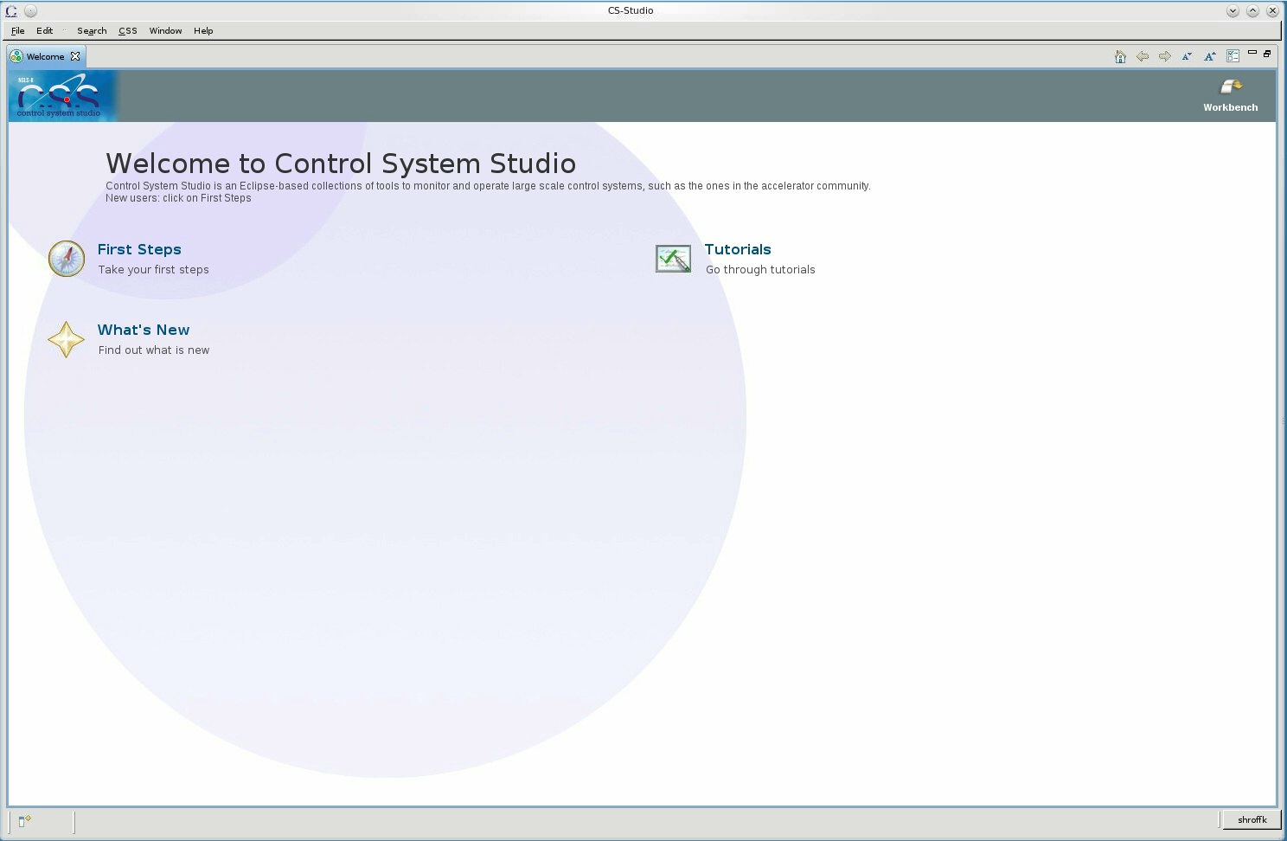
Demo

Slide 4
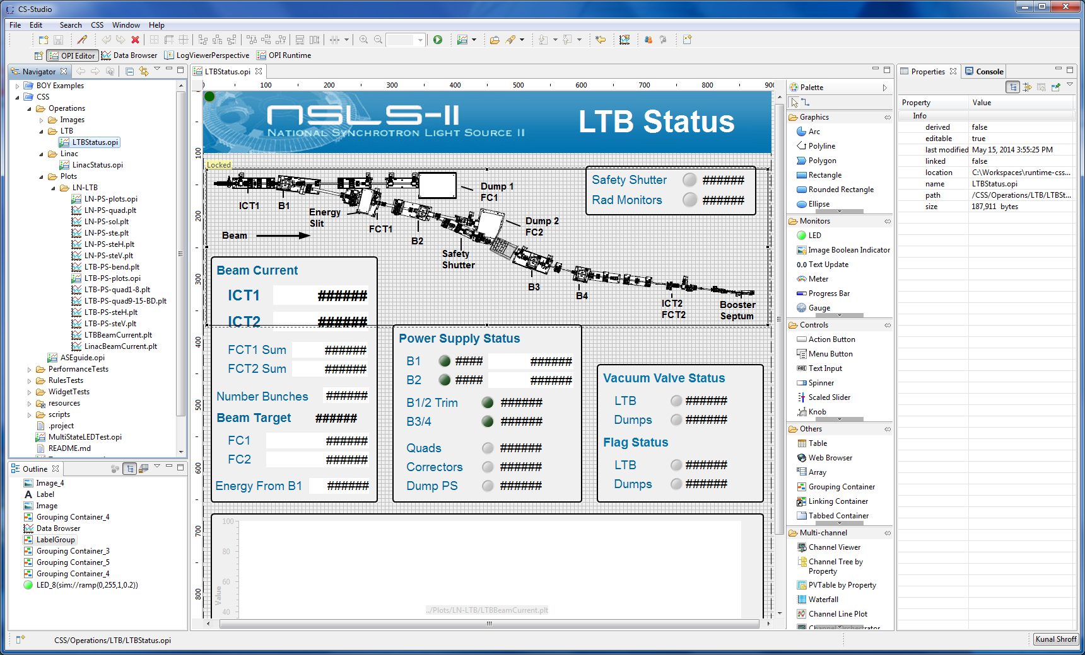
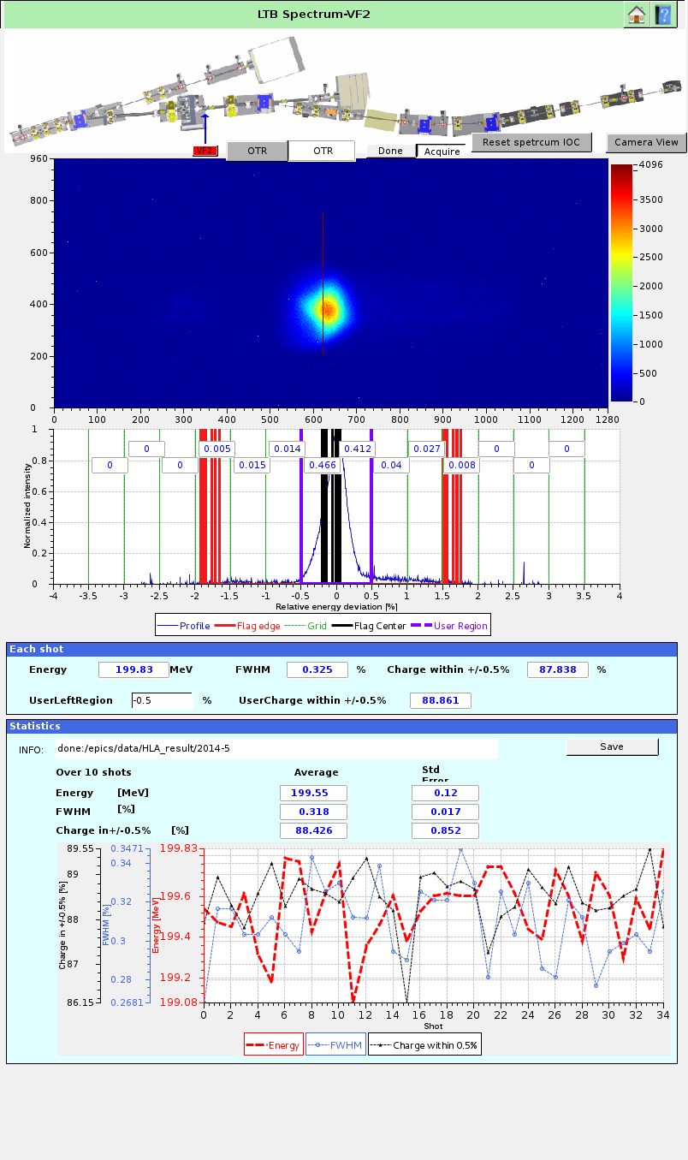
OPI editor and run environment

Slide 5
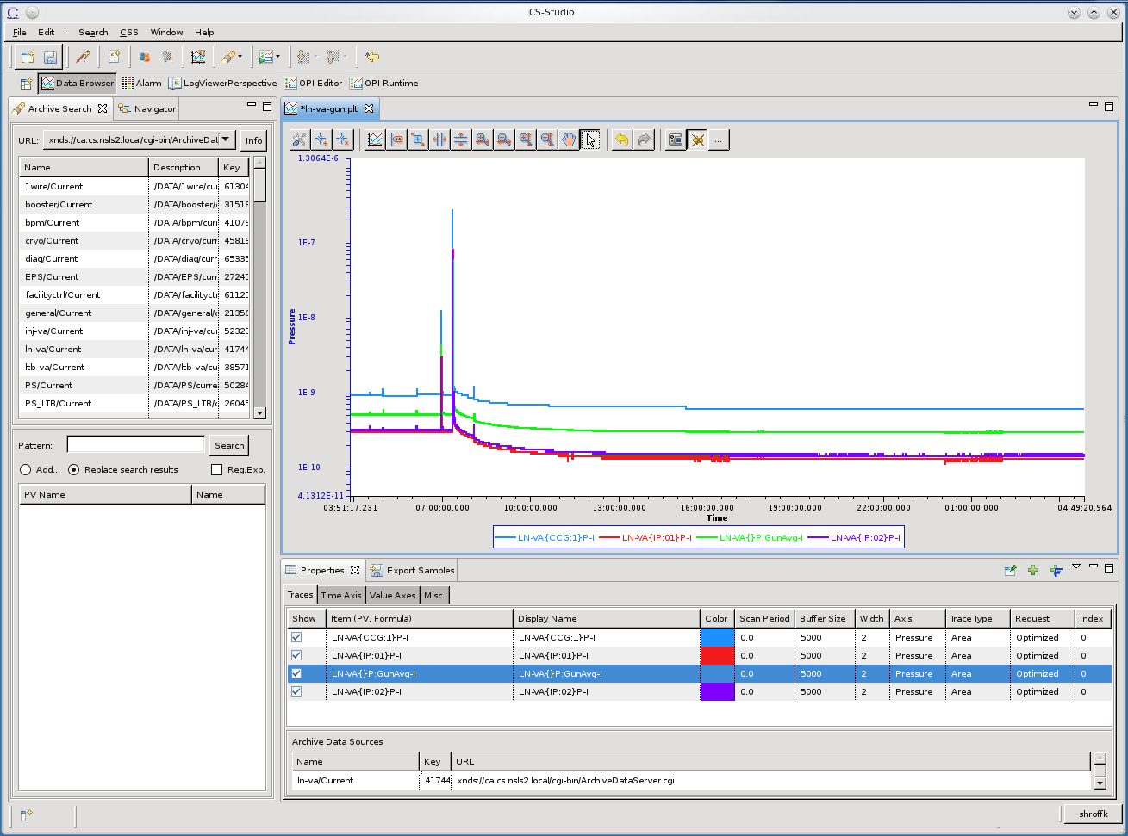
Viewer for Historic data

Slide 6
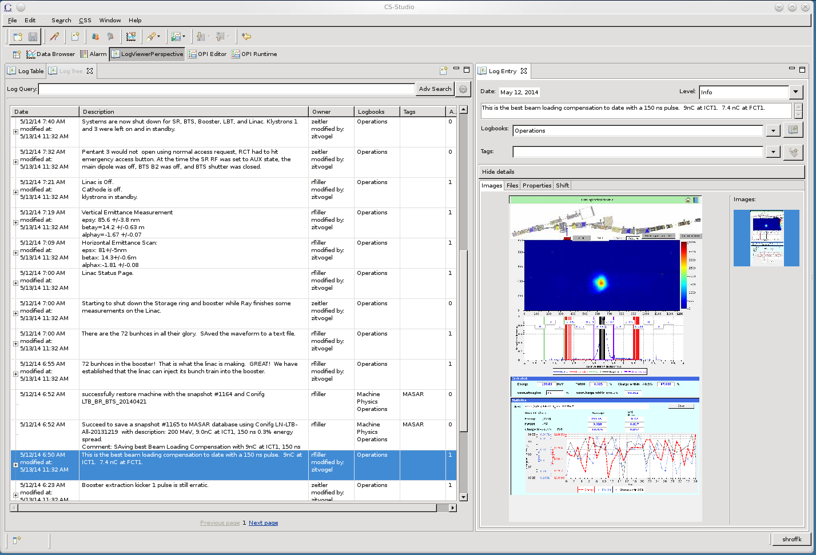
Log Viewer

Slide 7
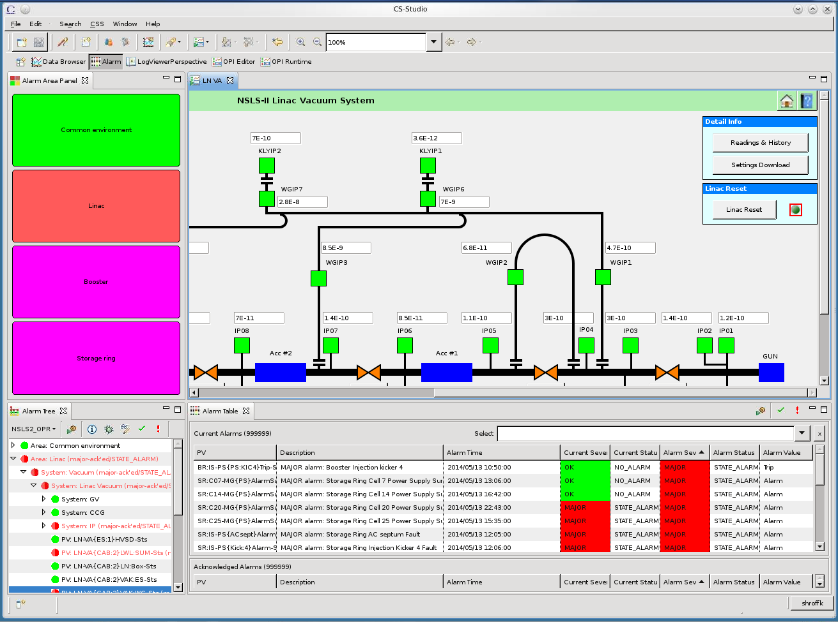
Alarm Viewer

Slide 8
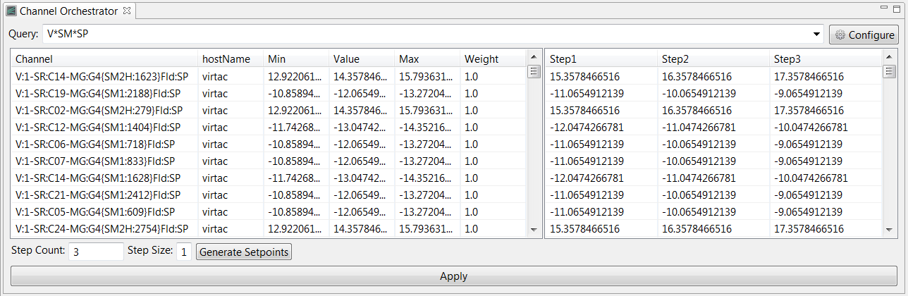
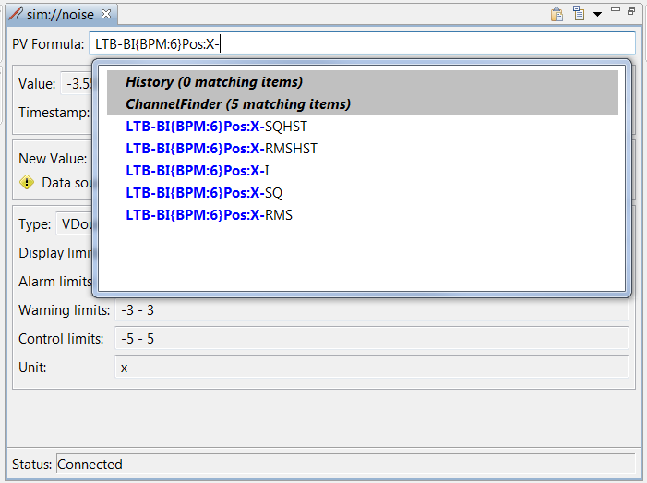
ChannelFinder

Slide 9
A Integrated set of tools
Control Systems (epics v3, v4)
BOY, probe, pvtable
Epics services
Alarms, Archiver, Save Restore
Utility Services
Logbook, Channel Directory, Shift
Physics services
Lattice, unit conversion

Slide 10
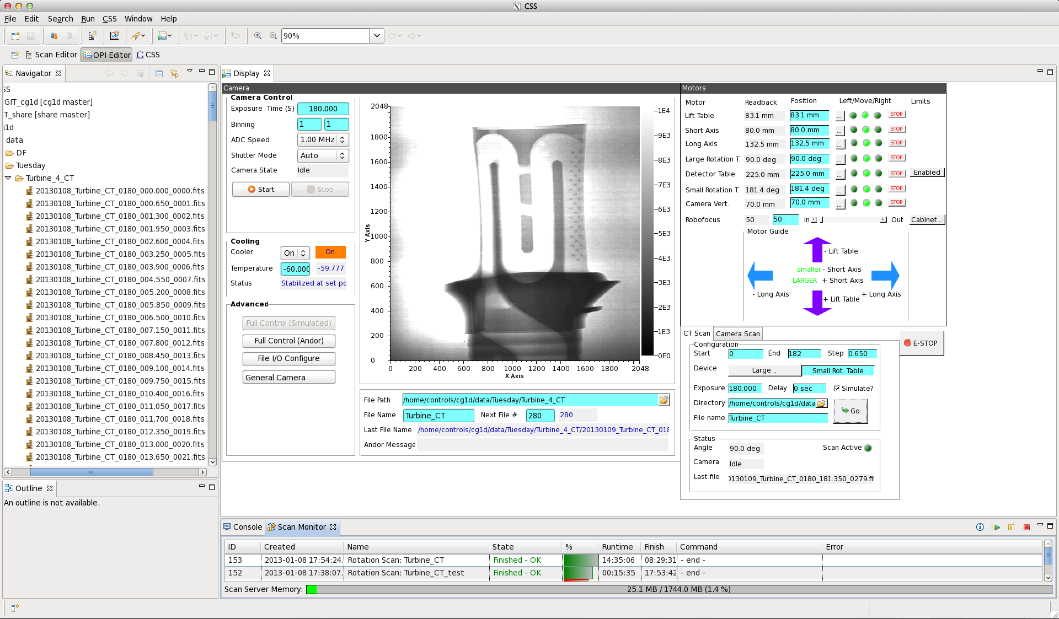
ORNL ‘CG-1D’ Beam Line
Neutron Tomography, EPICS/CSS since Jan. 2013
Kay Kasemir, USPAS2014

Slide 11
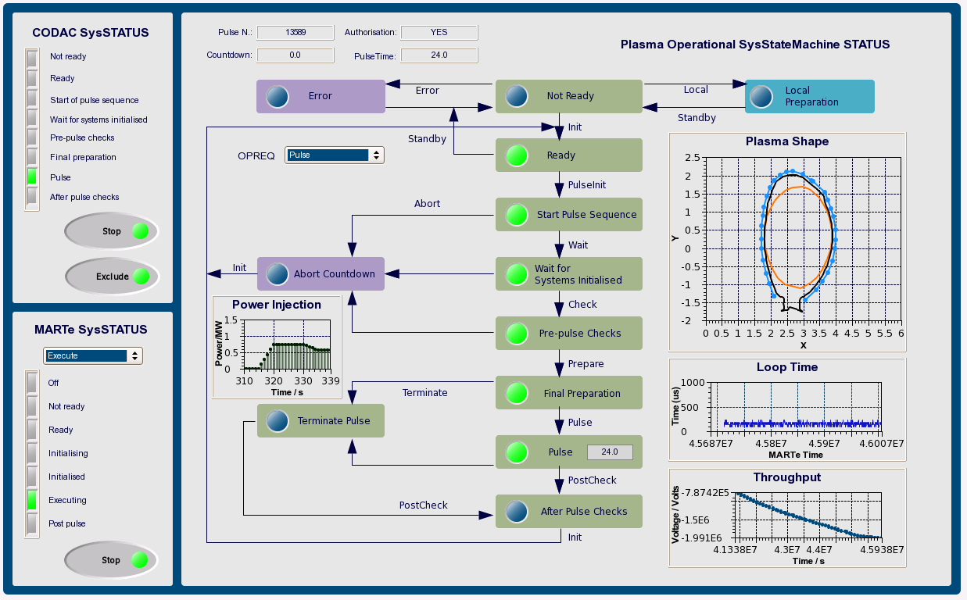
ITER-FPSC-vBetaVersionPanelsOPI
Neutron Tomography, EPICS/CSS since Jan. 2013
-UserManual.doc, Nadine Utzel, 2011

